Slide 1

Autonomous Intersection Management (AIM)
By: Team Trier Charles Arsenal Okere(Charles) Muhammad Amirul Hakimi bin Zaprunnizam(Amirul) Muhammad Iqbal bin Mohd Fauzi(Iqbal) Muhammad Farid Izwan bin Mohamad Shabri(Farid) Muhammad Amjad bin Abdul Malik (Amjad)

Slide 2
Problem?
Car crashes at intersection point or junction without traffic controls.
Time wasted
Emission
Heavy Traffic

Slide 3
Introduction
We began this research by outlining the most common technology used to solve the problem
Signal optimization with real-time CAV trajectory information
FCFS approach

Slide 4
MOTIVATION
A lot of studies have been done on a wide range of subjects.
Our topic requires us to conduct studies on a certain issue to and to acquire a generative notion about the automation intersection management which allows us to get interested in new ideas and approaches.

Slide 5
Model Design
Activity Diagram
Requirement Diagram
Use Case Diagram
Sequence Diagram
State Chart

Slide 6
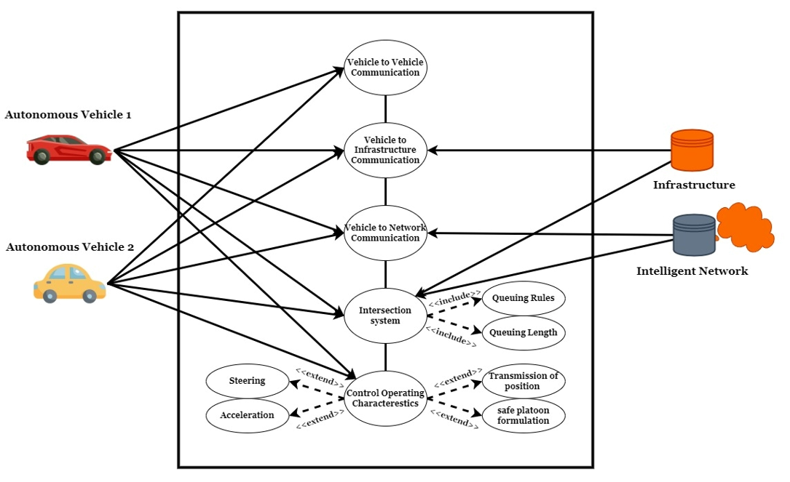
Use Case Diagram
To attain the aim of a totally autonomous driving car, the robot vehicle must have a thorough understanding of its surroundings.
Information that is required is based on onboard sensors which includes
1. Vehicle to Server Hub
2. Vehicle to Intelligent Network

Slide 7
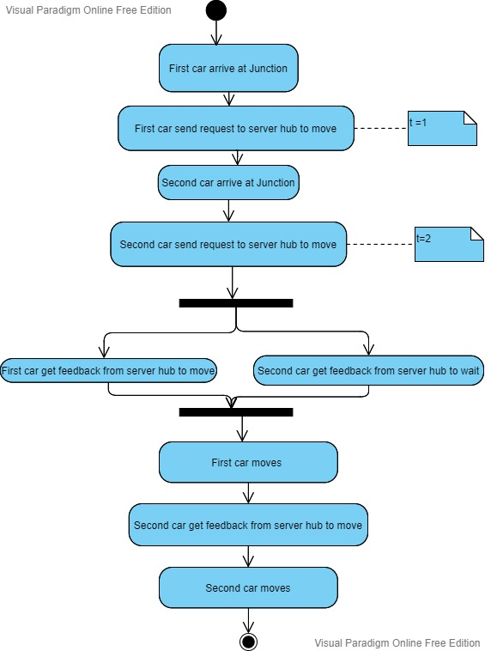
Activity Diagram for car scenario

Slide 8
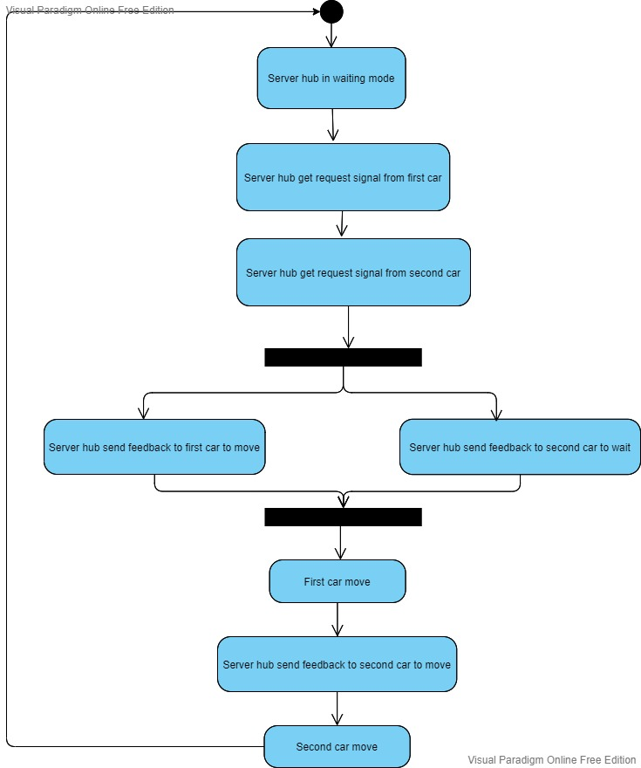
Activity Diagram for server hub

Slide 9
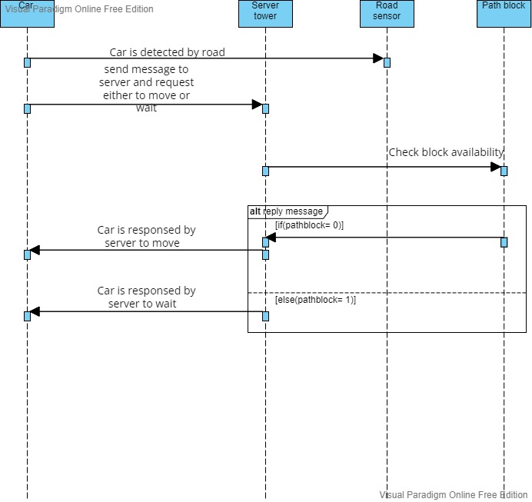
Sequence Diagram

Slide 10
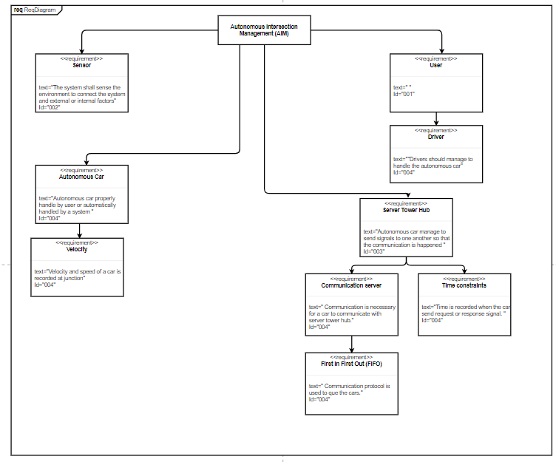
Requirement Diagram

Slide 11
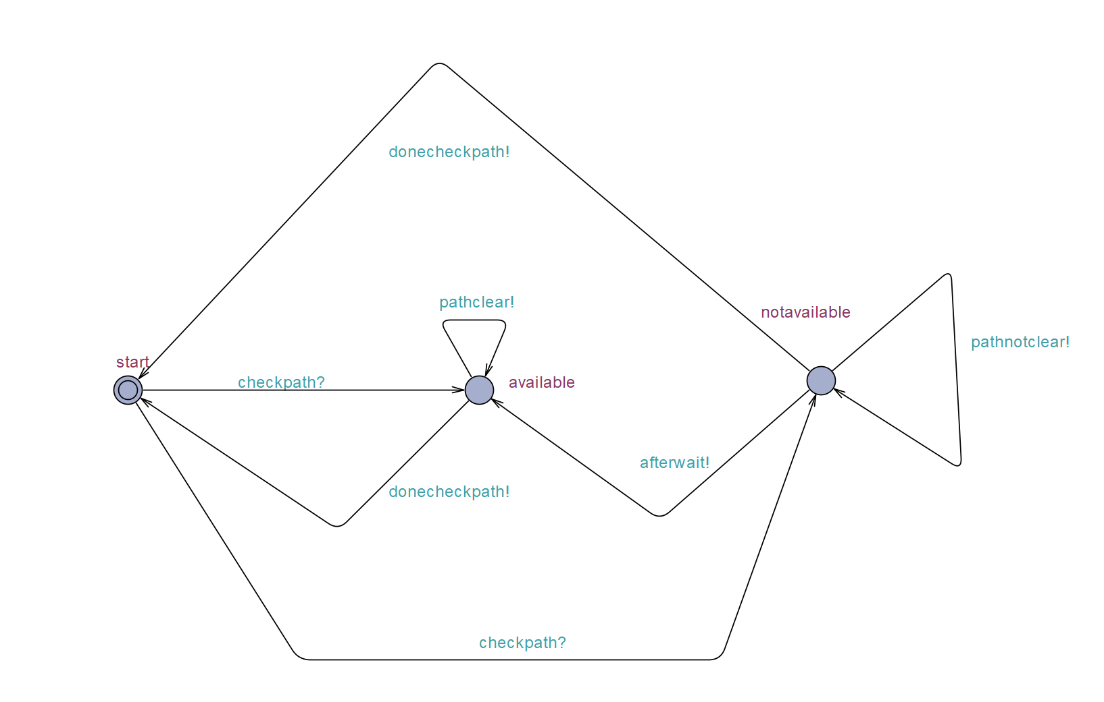
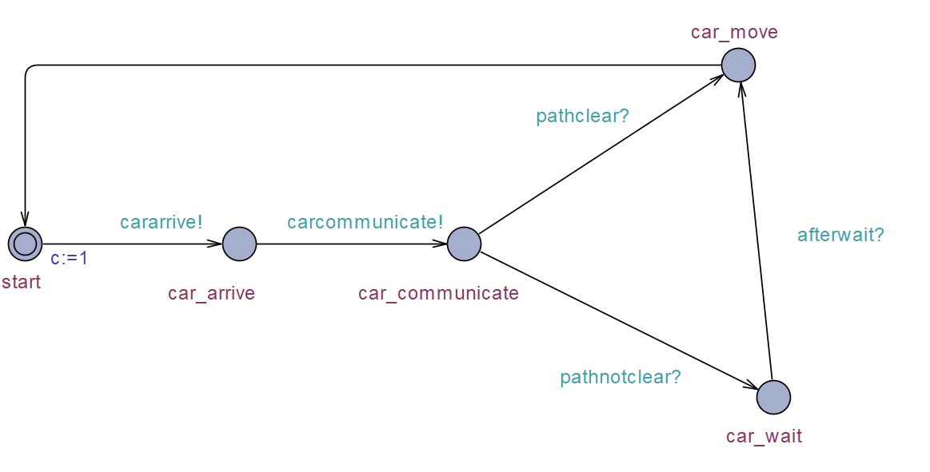
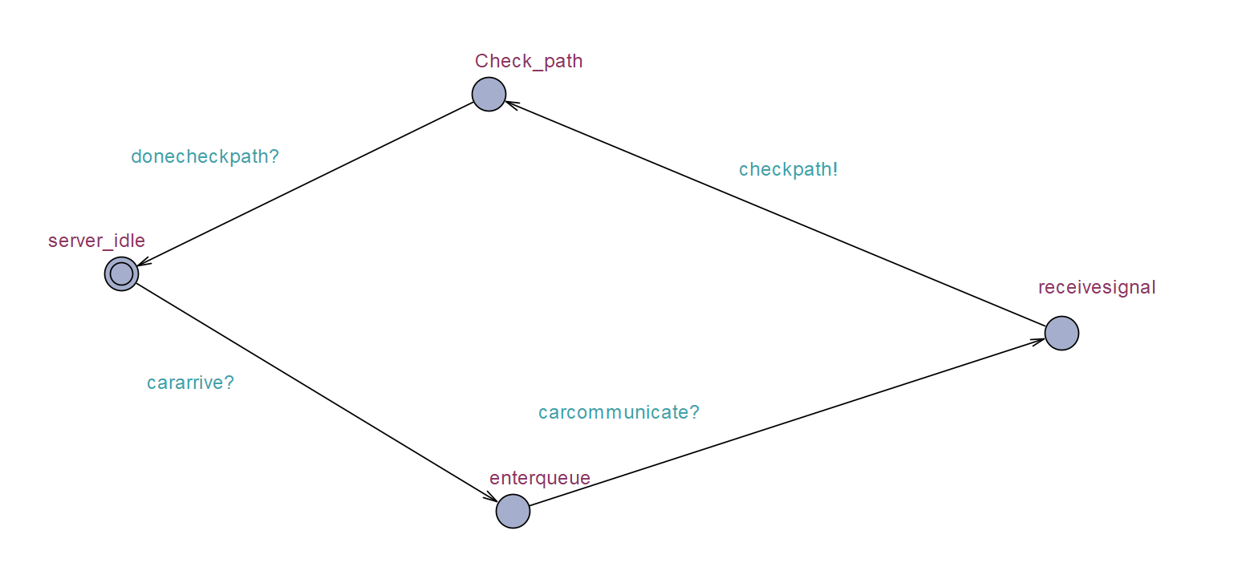
UPPAAL
Car State
Server State
Path State

Slide 12
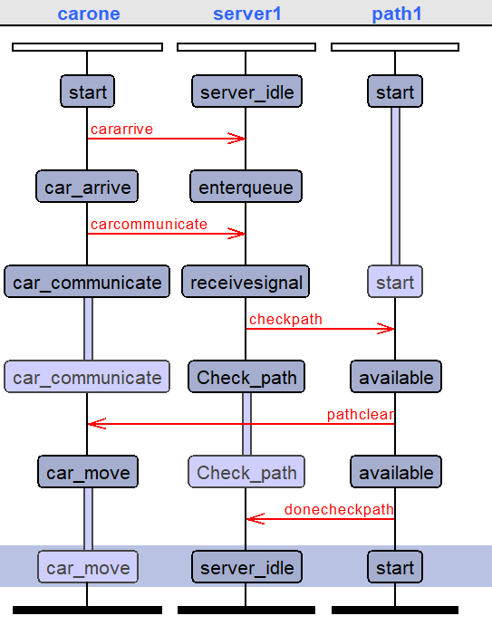
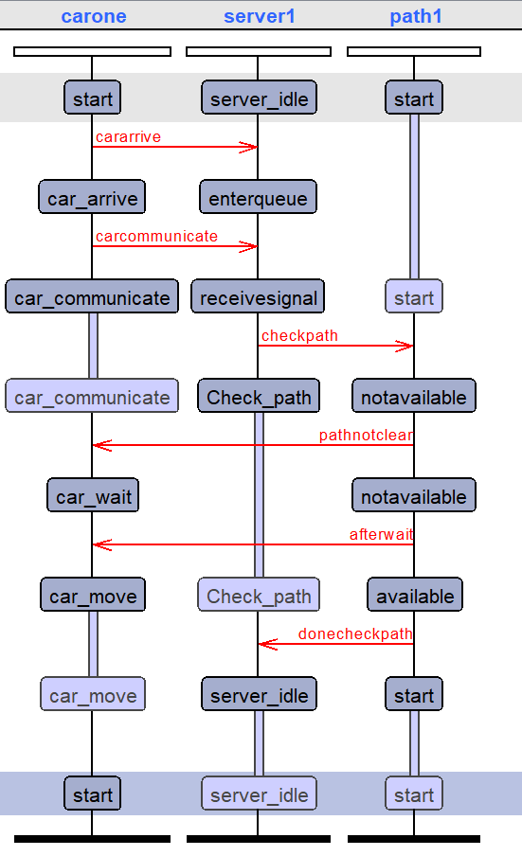
Simulation

Slide 13

Implementation

Slide 14

Real Time Operating System(RTOS)

Slide 15
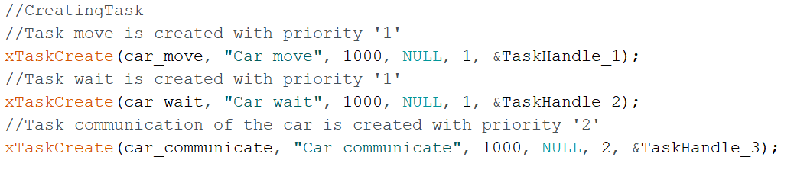
Create Task
car_communicate = priority “2”
car_wait = car_move = priority “1”
Priority 2 > Priority 1

Slide 16
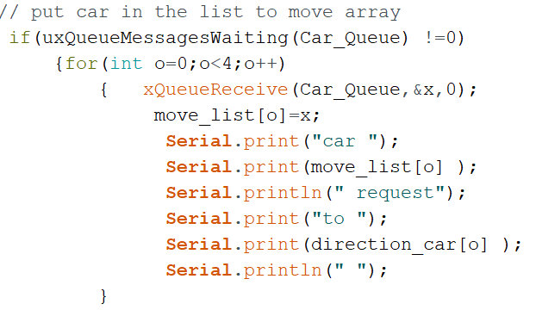
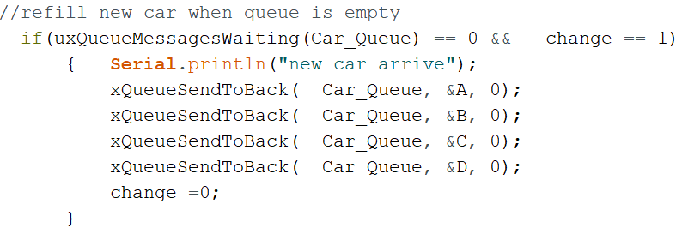
Queue Management
Task Communication

Slide 17
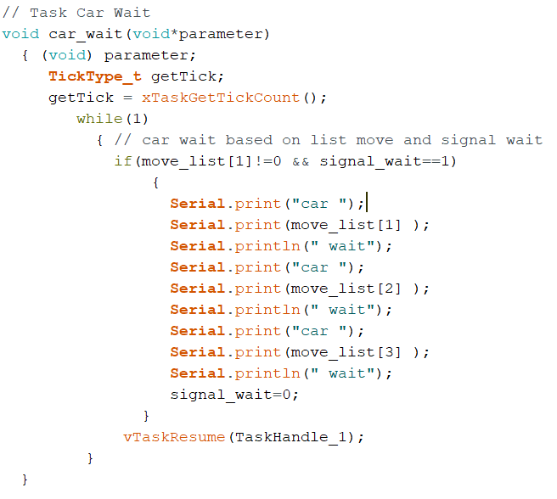
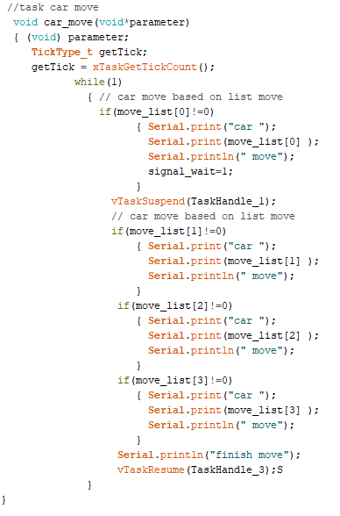
Concurrency

Slide 18
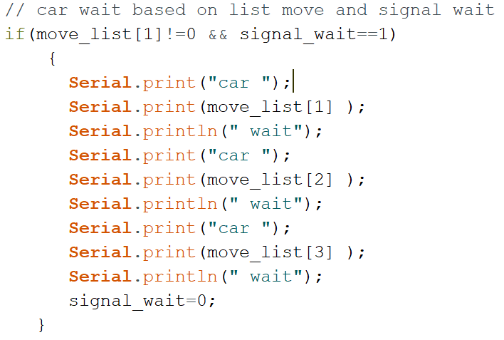
Wait Management
Car Wait Task

Slide 19
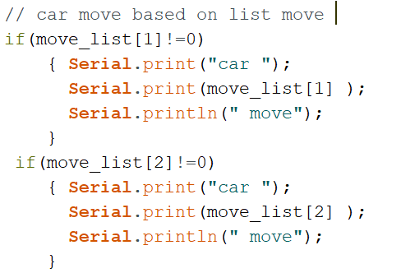
Moving Management
Car Move Task

Slide 20
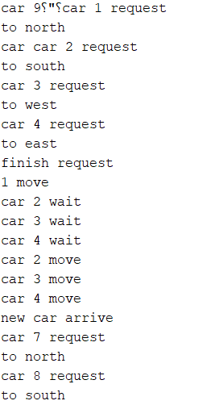
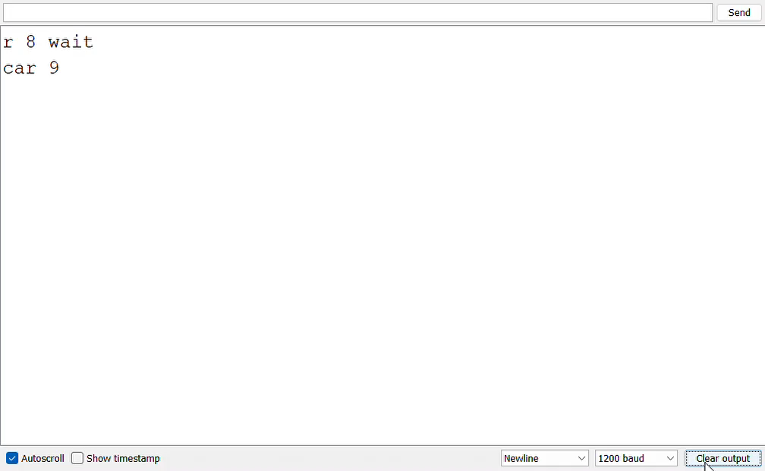
Result

Slide 21

VHDL

Slide 22
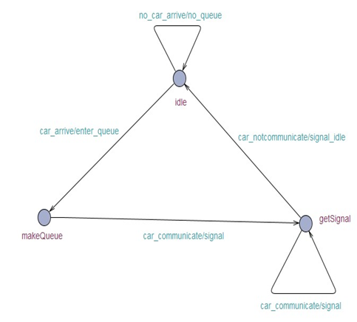
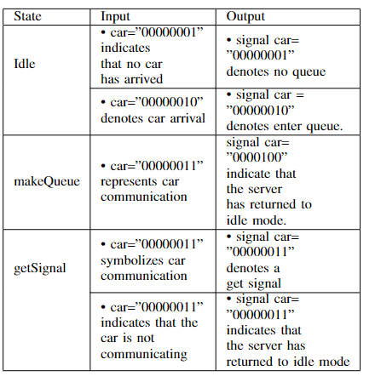
Finite State Machine (FSM)
Communication between car and server
Three state :Idle, makeQueue,getSignal

Slide 23
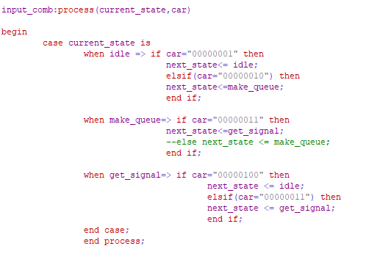
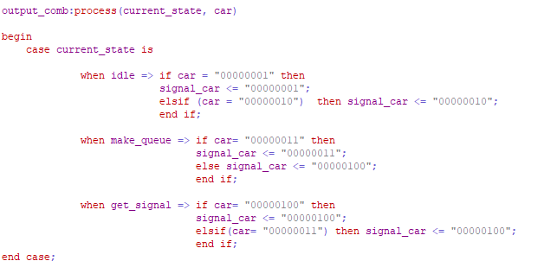
Input and Output

Slide 24
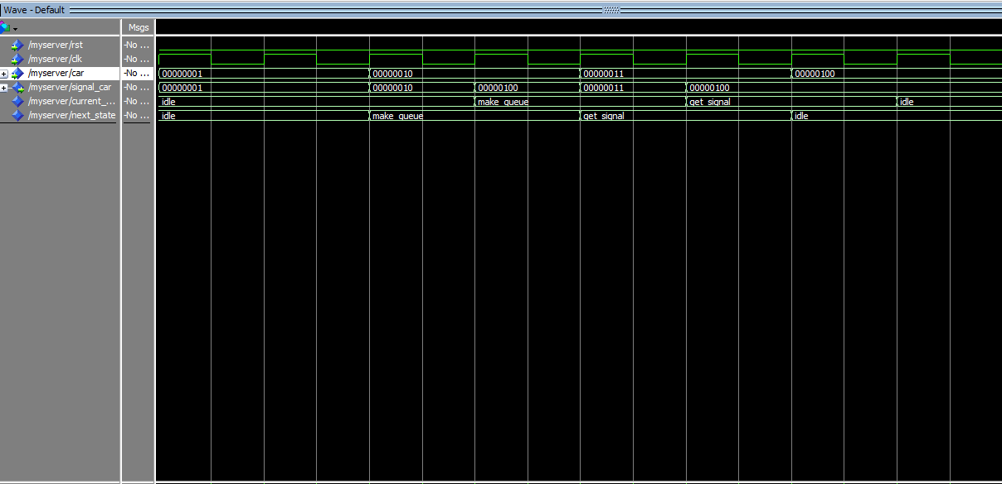
Result

Slide 25
Conclusion
In this project, a simple design model of AIM has fully discussed.
Since there might no traffic light in the future, it is benefit to use it in traffic management such as to avoid accident, heavy traffic, etc. This paper also provides diagrams that explained the structure of our system.

Slide 26
References
Team-Lamentis/Team-Lamentis- (github.com)
Ahn, H. and Del Vecchio, D., 2016, April. Semi-autonomous intersection collision avoidance through job-shop scheduling. In Proceedings of the 19th International Conference on Hybrid Systems: Computation and Control (pp. 185-194).
Azimi, R., Bhatia, G., Rajkumar, R.R. and Mudalige, P., 2014, April. STIP: Spatio-temporal intersection protocols for autonomous vehicles. In 2014 ACM/IEEE international conference on cyber-physical systems (ICCPS) (pp. 1-12). IEEE

Slide 27

Thank you

